Slide 1
NAS and Docker - Raspberry Pi
By
Kunal J. Tolani - 69
Nirbhay Pherwani - 49
Rohit Sachdev - 55

Slide 2
Abstract and Introduction
Our project deals with cloud services on the raspberry pi.
NAS has been setup using Samba server on the raspberry pi. A docker image has been installed which is not compatible with pi usually, but has been configured to work with raspberry pi. In addition to it, Pi-hole, Tonido, and Torrentbox has been setup on the pi.

Slide 3
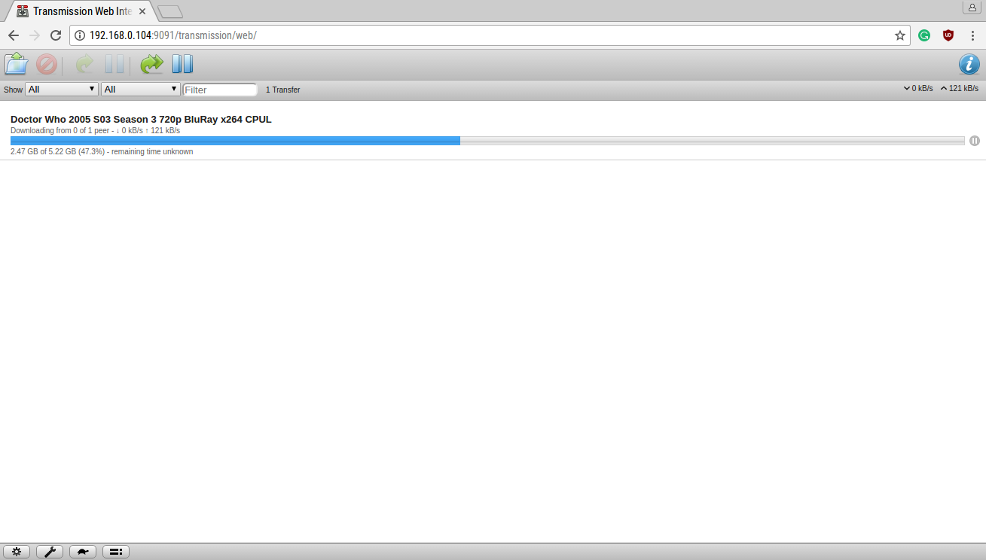
Torrentbox
Torrentbox basically turns the raspberry pi into a box which will download all your torrents. It makes use of the transmission bit torrent client and a web interface which can be configured for remote access.

Slide 4
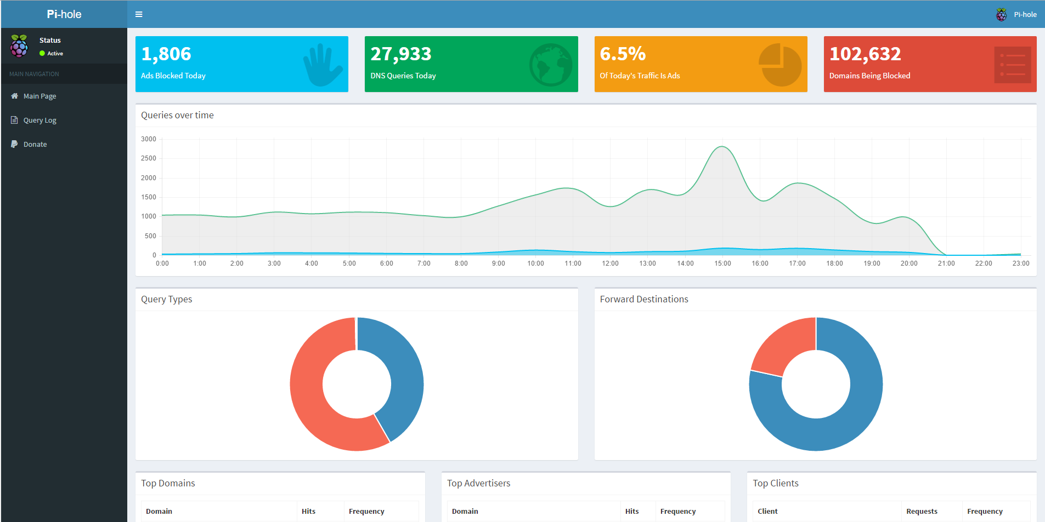
Pi-hole
Pi-Hole blocks ads of all sorts at the router level.

Slide 5
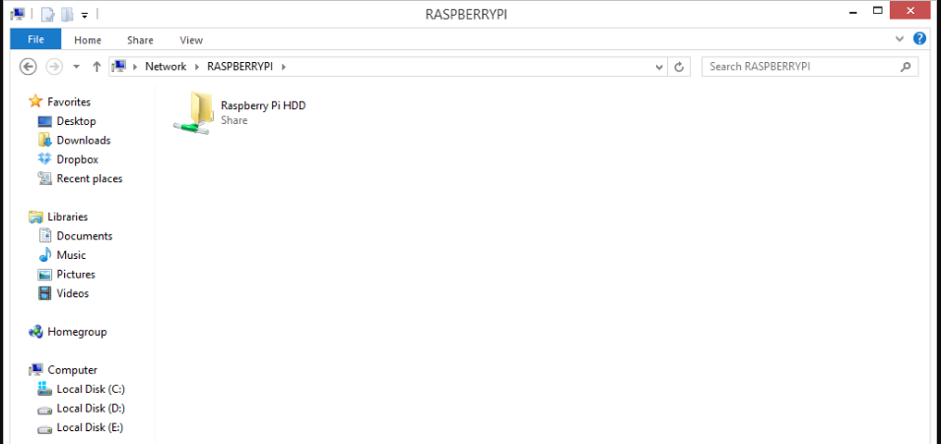
NAS
Network-attached storage (NAS) is a file-level computer data storage server connected to a computer network providing data access to a heterogeneous group of clients.

Slide 6
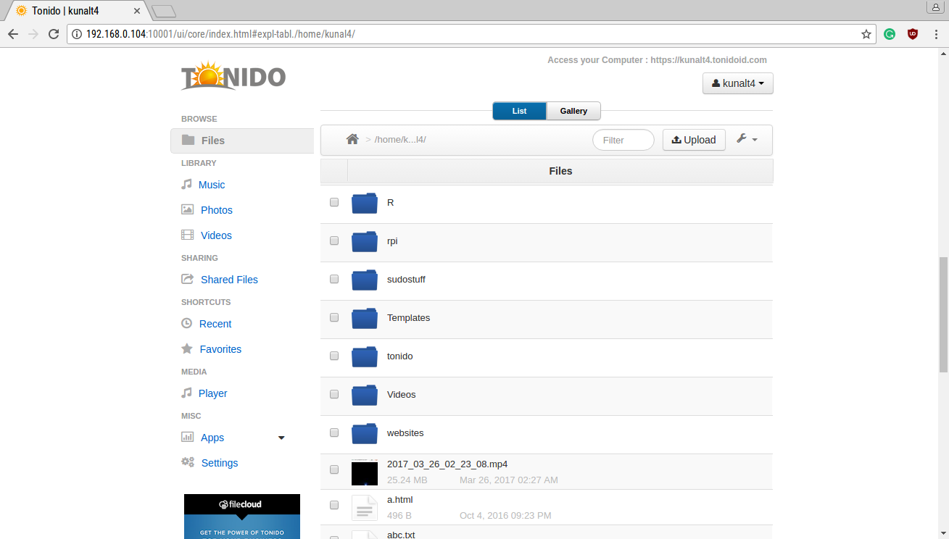
Tonido
Tonido is basically a simple platform to make all your files available over the internet remotely, turning your computer or device to a cloud platform.

Slide 7
CONCLUSION
We setup a multi-purpose cloud service on the raspberry pi.
Docker, Torrentbox, Pihole, Tonido and NAS using Samba, all have been setup and running on the Pi.

